Slide 1
LANGGRAPH BOOTCAMP
Lang Graph is a Python library built on top of Lang Chain, designed for creating and managing complex, stateful workflows or "graphs" for AI applications, using large language models (LLMs).
Using Lang graph developers will create graph-based AI agents where nodes represent logic (like LLM calls or functions) and edges represent transitions between these steps.
While Lang Chain allows the creation of Directed Acyclic Graphs (DAGs) for linear workflows, Lang Graph takes this a step further by enabling the addition of cycles, which are essential for developing complex, agent-like behaviors.

Slide 2
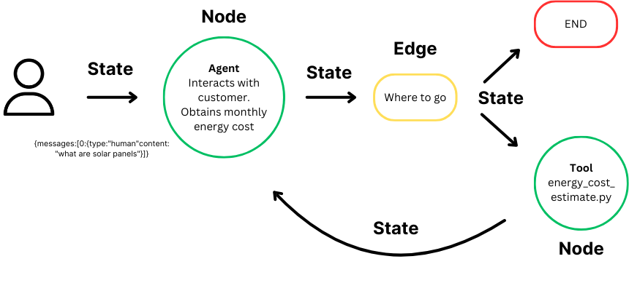

Slide 3
STATE--> NODE --> EDGE --> END
StateGraph: | The graph structure where you define nodes (functions) and edges (transitions).
Node: | A step in the process, e.g., a call to a language model or a tool.
Edge: | Defines how the process flows from one node to another.
State: | Shared memory between steps (e.g., messages, variables, tools).
END: | Special keyword to end execution.

Slide 4
At the heart of LangGraph is the concept of a stateful graph:
State: Represents the context or memory that is maintained and updated as the computation progresses. It ensures that each step in the graph can access relevant information from previous steps, allowing for dynamic decision-making based on accumulated data throughout the process.
Nodes: Serve as the building blocks of the graph, representing individual computation steps or functions. Each node performs a specific task, such as processing inputs, making decisions, or interacting with external systems. Nodes can be customized to execute a wide range of operations within the workflow.
Edges: Connect nodes within the graph, defining the flow of computation from one step to the next. They support conditional logic, allowing the path of execution to change based on the current state and facilitate the movement of data and control between nodes, enabling complex, multi-step workflows.

Slide 5




LangChain vs LangGraph vs LangFlow vs LangSmith
If you're building AI generative apps, you’ve likely come across
LangChain: The foundational framework for connecting language models to tools and APIs
LangGraph: The orchestrator for multi-agent systems and complex workflows
LangFlow: The visual, drag-and-drop UI for prototyping AI apps
LangSmith: The real-time debugging and monitoring platform 🚀 Perfect for developers, AI builders, and anyone looking to level up their AI development stack fast

Slide 6
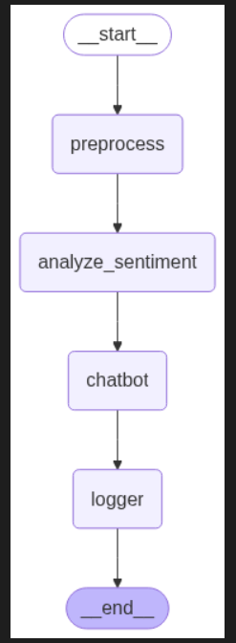
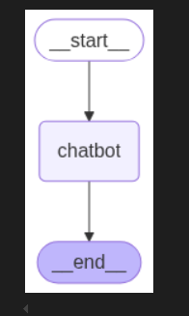
LangGraph Practicle -->

Slide 7
Previous Workshop
1- Agenitic AI :- youtube.com/playlist?list=PLVlQHNRLflP8Pt3wVlRWRaXZXi79cIwSq
2- Data Analytics & Business Analytics:-
https://www.youtube.com/playlist?list=PLVlQHNRLflP-BgYmMlM8YQpvQM2J99HE0
3- Generative AI :- youtube.com/playlist?list=PLVlQHNRLflP81c99eg7UhkVZxwPvhTddM
4- Python for Data science :- www.youtube.com/playlist?list=PLVlQHNRLflP9GN5rc8sBWnrV53DWAzfdn
5- AZUR AI (Cognitive Services) :- www.youtube.com/playlist?list=PLVlQHNRLflP8JthpjvJFaofUkJS1A7qa1
6- Resume Building Bootcamp for Data Analytics, BA, Data Science & GEN AI Roles :-
youtube.com/playlist?list=PLVlQHNRLflP-SaPff3325gkISMHEznEix
7- Resume Building Bootcamp for Data Analytics, BA, Data Science & GEN AI Roles :-
www.youtube.com/playlist?list=PLVlQHNRLflP9vV2_FO8h1yiVD90XhJy8M

